Slide 1
Employee Payroll System
N. Jayasri sri - AP22110011319
V.N. Renusri - AP22110011339
J.Maheswari - AP22110011348K
K.N Sahithi - AP22110011352
T. Samanvitha- AP22110011353

Slide 2
INTRODUCTION
In this app we replaces traditional spreadsheets or web portals with a mobile-first approach.
Designed to function fully without internet, ideal for remote or field-based use.
Supports two user roles: Administrator (full access) and Employee (read-only).
Returning users log in securely and are redirected based on their role:
Admins gain access to tools for creating, editing, and managing payroll records.
Employees are provided with a simple, read-only view of their personal payslip.

Slide 3
OVERVIEW
Follows a modular design with five main activities:
1.SplashActivity
2.LoginActivity
3.RegisterActivity
4.MainActivity (for Admin)
5.ViewSalaryActivity (for Employee)
Admins can add/edit/delete salary records.
Employees can view their personal salary slips only.
Built with intuitive navigation and clear role separation.
We uses data base layer and UI layer as architecture.

Slide 4
Data Base
Layer | Purpose | Key Components | Technologies / Methods Used | Examples / Functions
Database Layer | Store and manage employee and user data securely | DatabaseHelper, DBUserHelper | SQLite, Parameterized SQL Queries, Transactions | insertEmployee(), updateEmployee(), insertUser(), checkUser()
 | Separate logic for payroll and user authentication | Separate tables for employees, users, payroll | Entity-Attribute-Value schema for extensibility | Allows adding new payroll components without schema redesign
 | Ensure data integrity and validation | Schema constraints, validation during insert/update | Transaction management, data type checks | Prevents partial updates or corrupt records
UI Layer | Provide interactive user interface and experience | Java Activities, XML Layouts | Android SDK, ConstraintLayout, Material Design Guidelines | LoginActivity, RegisterActivity, MainActivity, ViewSalaryActivity
 | Handle user input and display feedback | Forms, inline error messaging | EditText, Toasts, TextInputLayout | Real-time validation for email, password, salary fields
 | Ensure visual consistency and responsiveness | Shared styles, adaptive layouts | Dimension resources, themes, colors | Works well on phones and tablets

Slide 5
Challenges and Solutions
Ensuring secure login was critical - we solved this using Parameterized queries to prevent SQL injection and misused credentials.
Role-based access control required precise navigation logic —
we directed users to specific dashboards (Admin or Employee)
based on their stored role.
Our initial fixed payroll schema was inflexible - we refactored
it into an Entity-Attribute-Value model for better scalability.
Handling UI consistency across devices - was tough

Slide 6
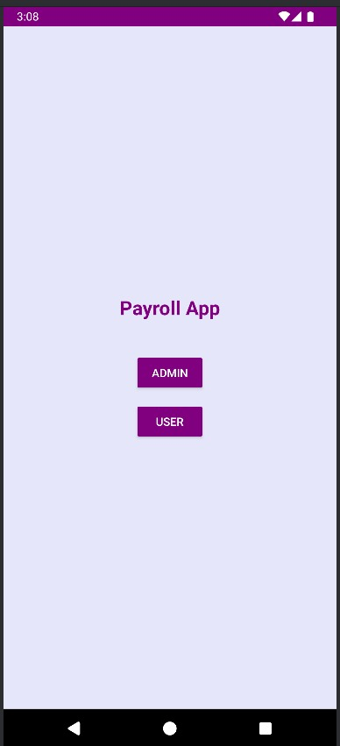
Conclusion
The Employee Payroll System project successfully delivers a robust, role-based payroll management application tailored for Android devices. The application reflects scalability and foresight, with clear provisions for future enhancements such as:
Password encryption and secure storage
Cloud synchronization using Firebase or backend APIs
Advanced reporting and analytics
Cross-platform integration

Slide 7
THANK YOU

